Slide 1
Group Lab 2 Presentation
Capstone Team 2:
Kathy A. Brett
Vamshi Krishna Jonnada
Nicole L. Justice
Kishore K. Kovuru
Jessica Reyes

Slide 2
Problem statement
Crime is an unwelcome issue within any neighborhood. While this has a public safety impact, it is also assumed to have a monetary impact with the potential to have a negative effect on home sale values. Little is known regarding the impact of local crime statistics on how a tax auditor determines residential home sale values for Charlotte, NC. This creates limitations for homeowners, buyers, sellers, and real estate agents at being able to make good decisions about home sales transactions.

Slide 3
Analysis research approach
To determine if a correlation exists between crime rates and residential sales prices, our analysis has included comparing neighborhood “hotspots” within Charlotte, NC. We expect to complete a time series trend analysis of those hotspots with the highest and lowest crime rates in the greater Charlotte, NC area, against the sales prices over the last 6 years.

Slide 4
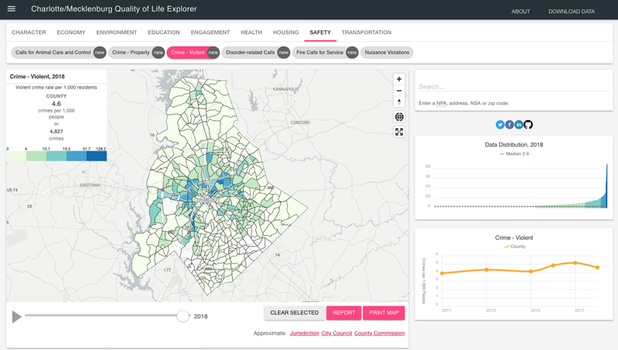
Data gathered for Tableau visualizations
Charlotte/Mecklenberg Quality of Life Explorer (http://mcmap.org/qol/)
Over 80 variables providing info about housing, crime rates and more
Maps, trend information, data tables and summary reports for 462 neighborhood profile areas (NPAs)

Slide 5
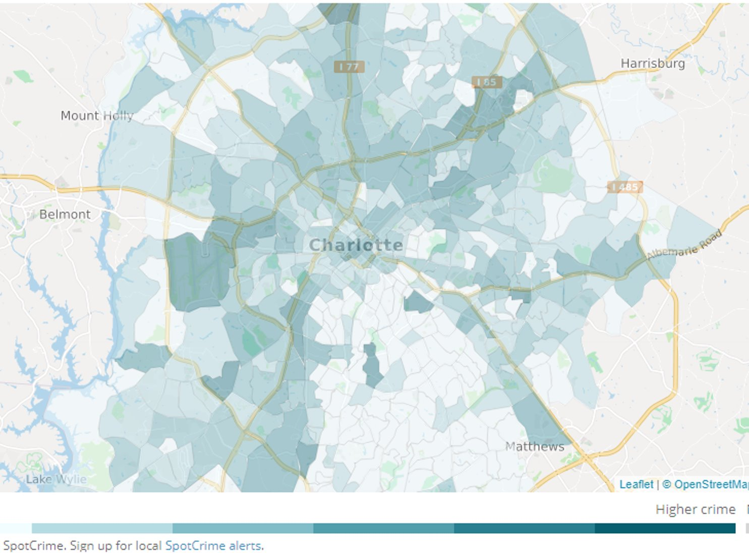
Standardizing data
Filtered the number of NPAs to "hotspots" of crime in Charlotte
Housing prices for NPAs: only 2016 and 2018 available

Slide 6
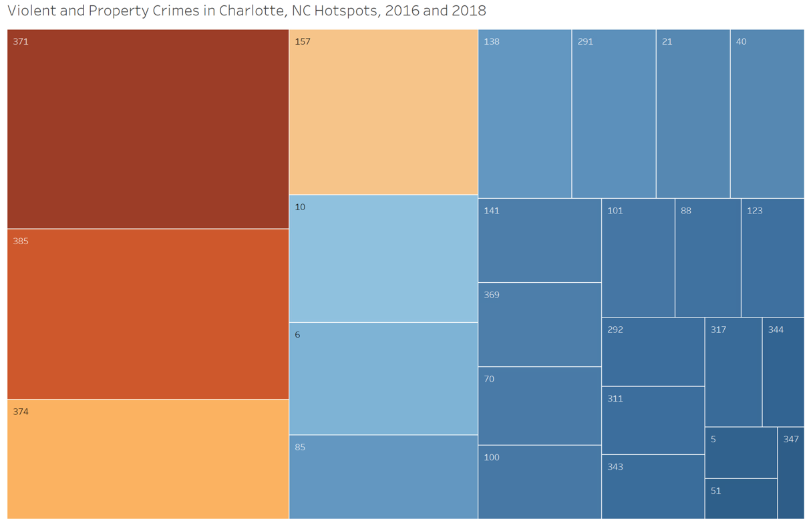

Slide 7
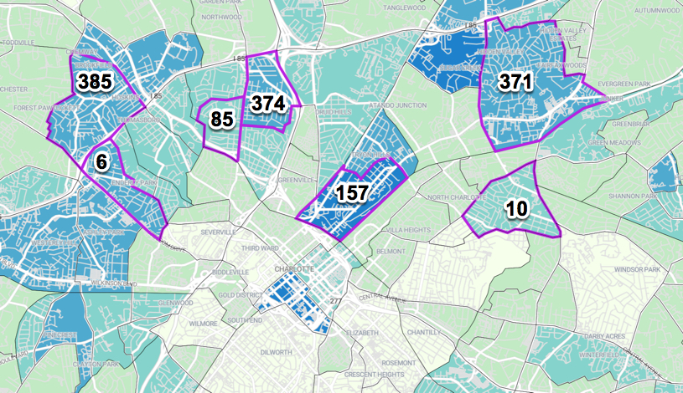
Many NPAs with high rates of violent and property crime are located north of Charlotte, along I-85.

Slide 8
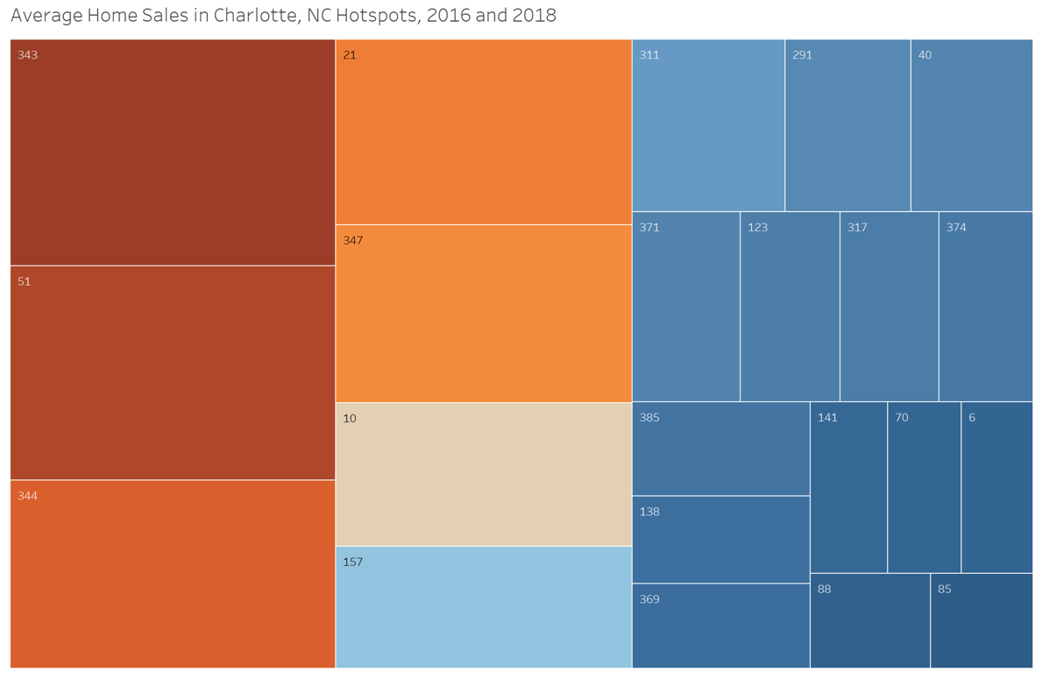

Slide 9
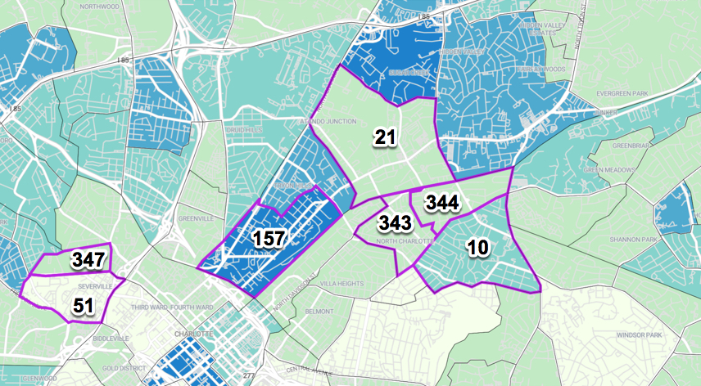
NPA 10: worth investigating further.
NPAs with higher house prices are located closer to Charlotte, further from I-85.

Slide 10
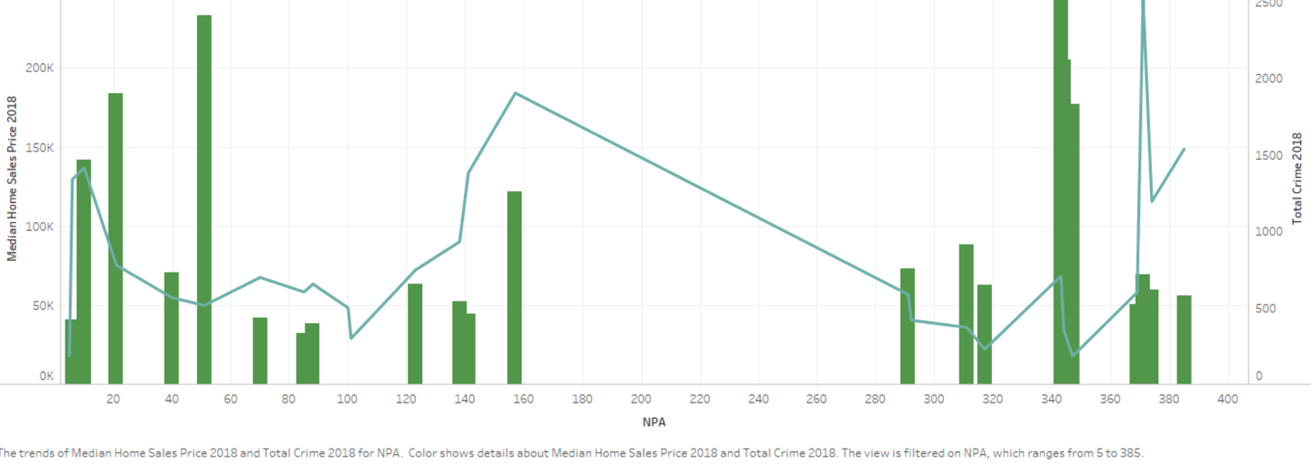


Crime – Sales NPA Correlation 2018

Slide 11
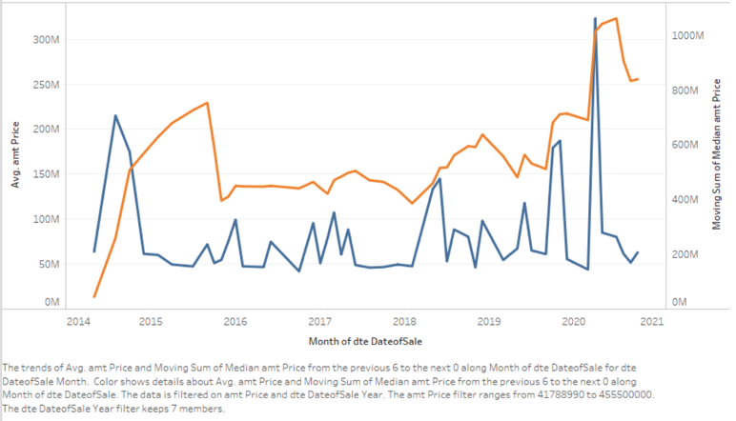

Average Sales Price/Moving Average 2014 -2020

Slide 12
Next steps
Obtain more information about sales prices by neighborhood in Charlotte beyond 2016 and 2018
Work on hotspot map
Continue our analysis on understanding the correlation of crime statistics against sales prices

